Slide 1

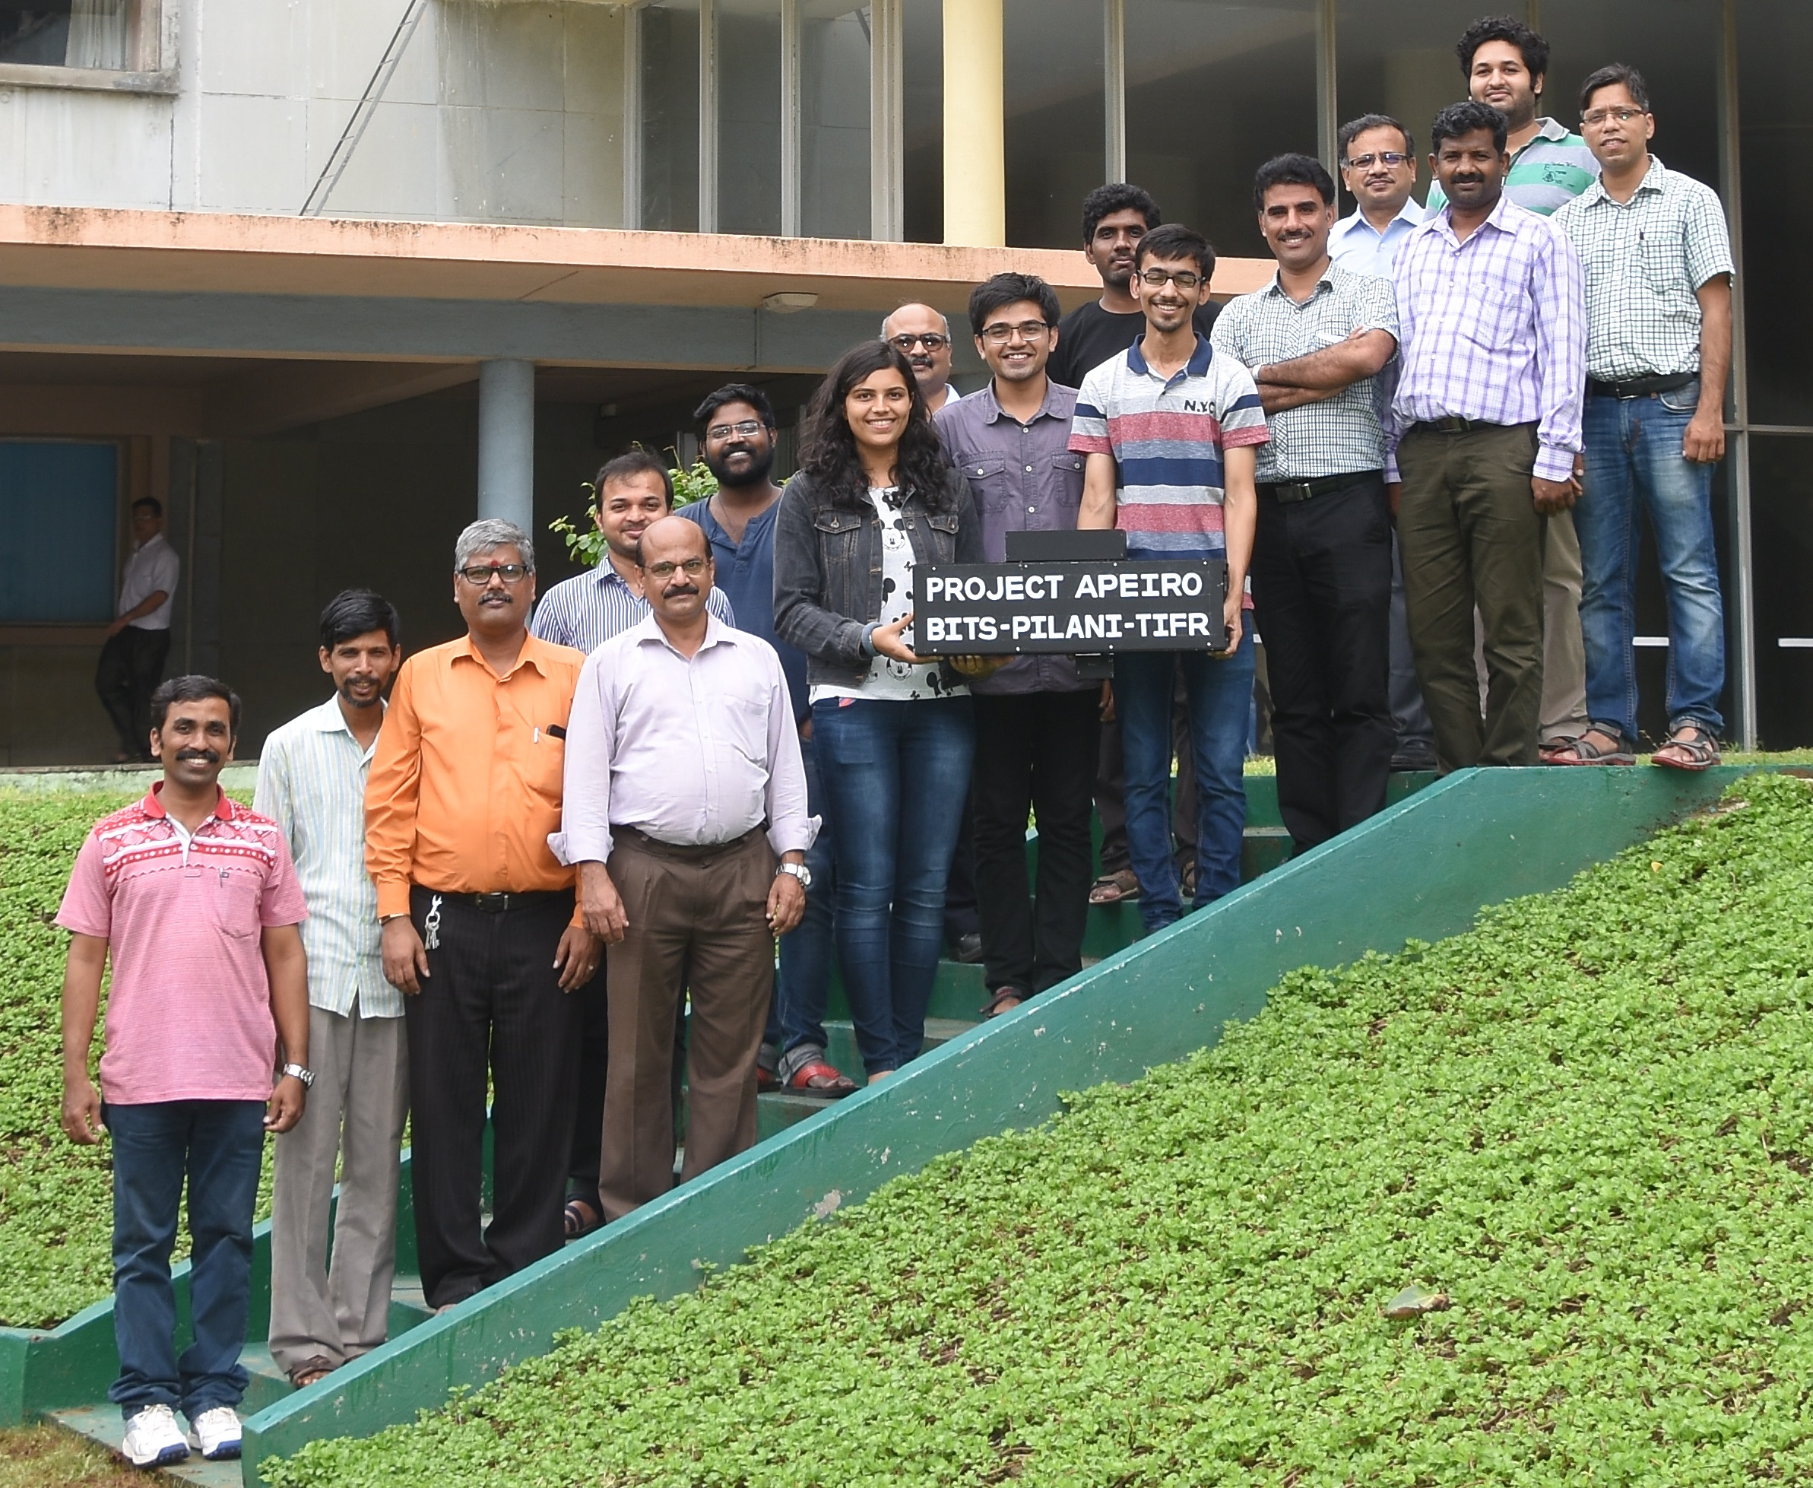
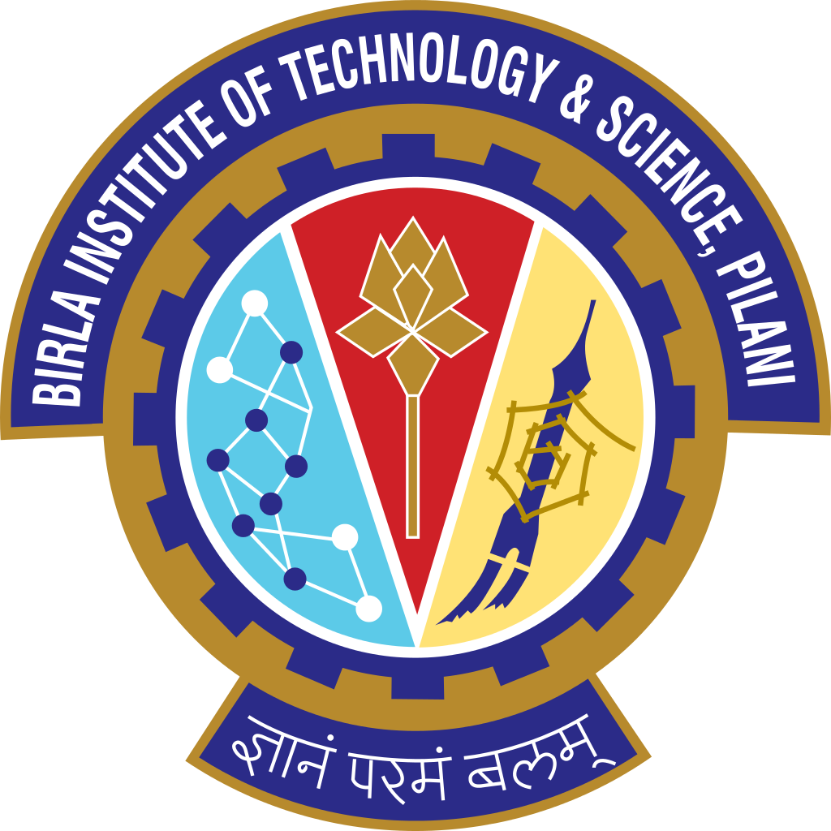

Project Apeiro
Airborne Payload for Cosmic Ray Flux Measurement and Analysis
www.project-apeiro.com

Slide 2
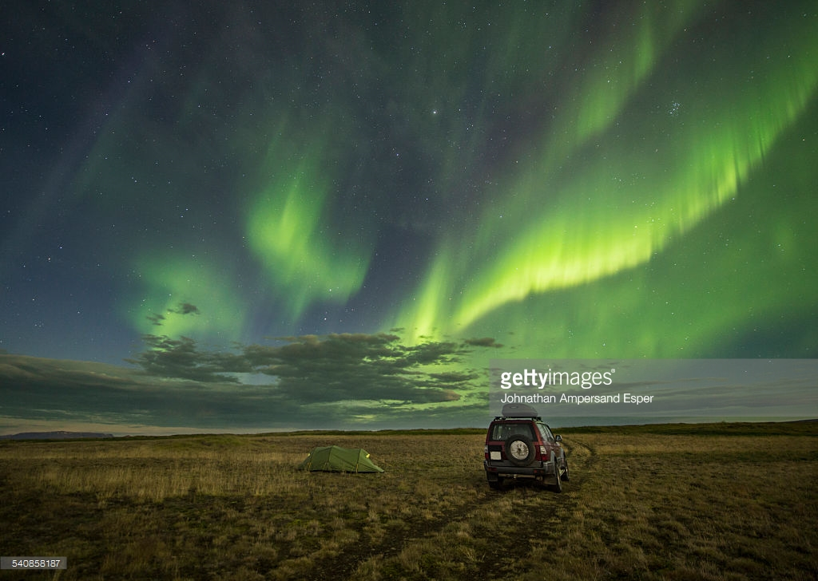
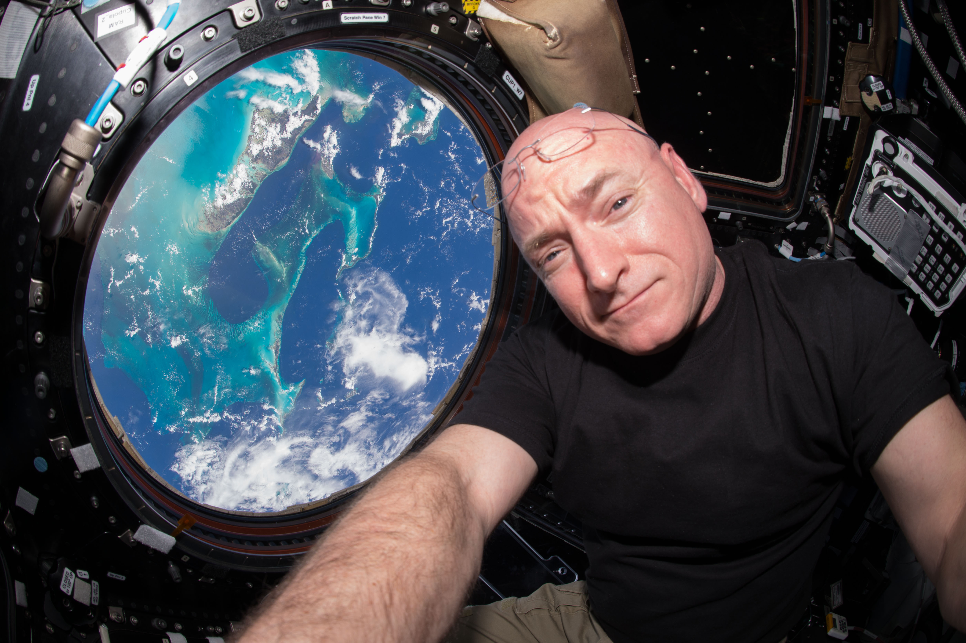


What are cosmic rays?

Slide 3
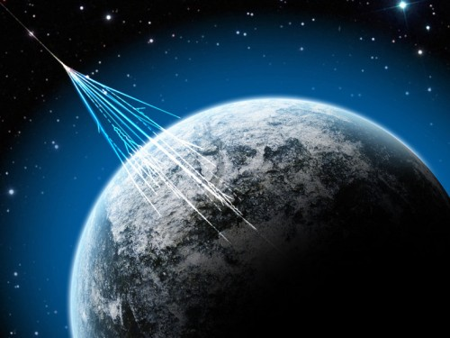
What are cosmic rays?
Charged particles
Incident on surface of Earth from all directions
Most likely sources: Sun, distant nebulae, supernova, etc.
The primary shower interacts with Earth’s atmosphere to form the secondary shower
artist impression from www.earthsky.org

Slide 4
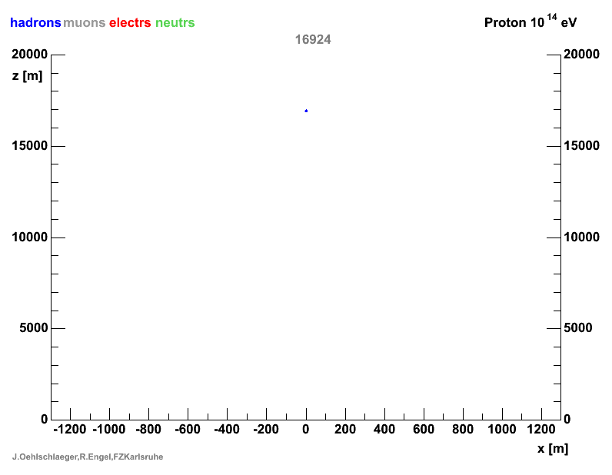
Cosmic Ray Shower
Corsika simulation of 100TeV proton primary cosmic ray generating secondary cosmic ray shower

Slide 5
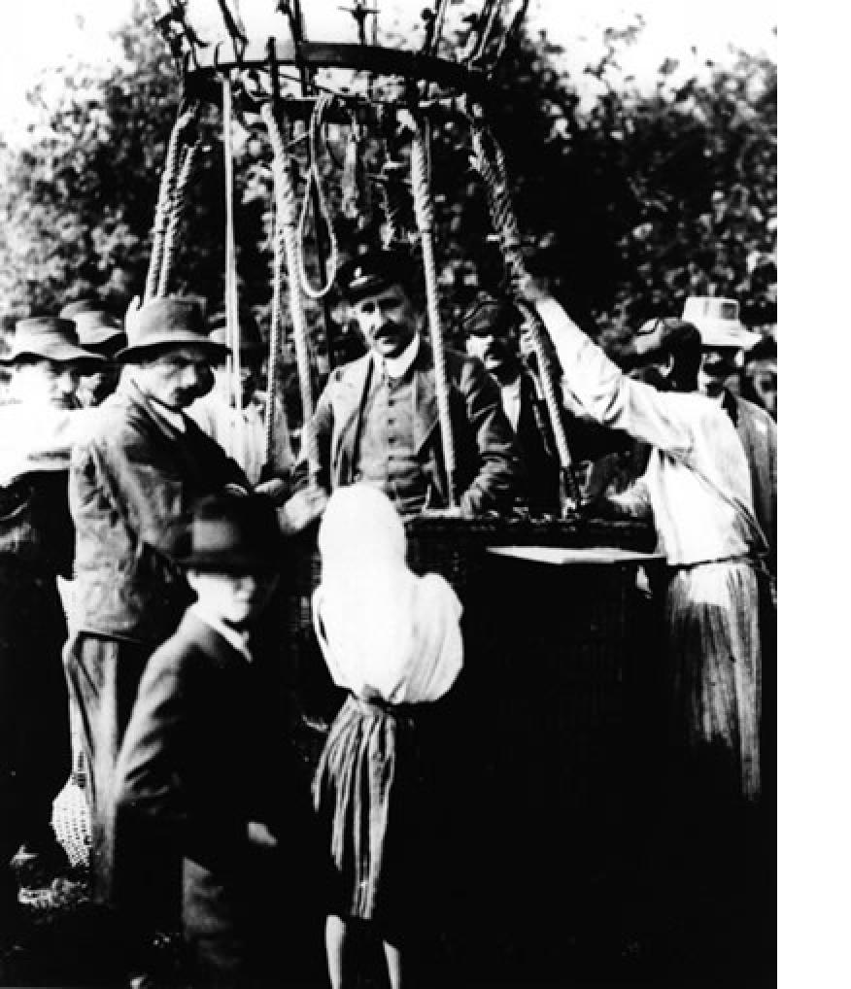
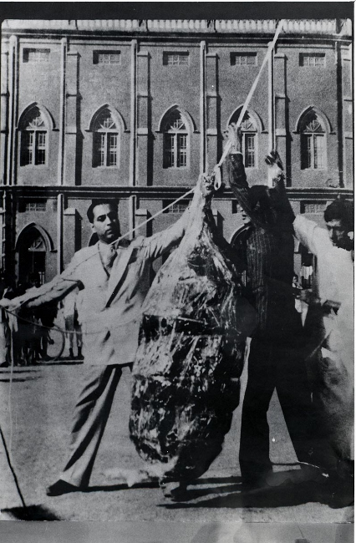
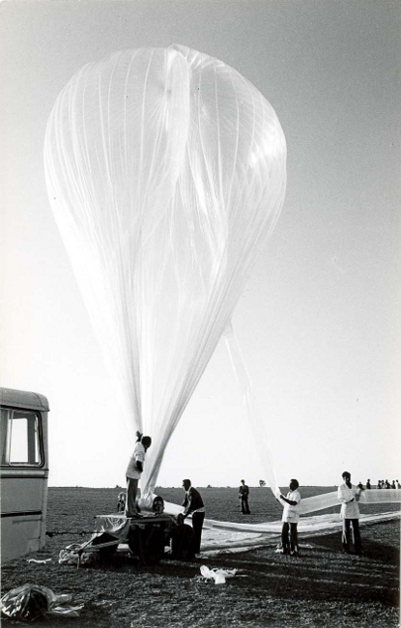
Cosmic Ray Physics
Hess during his balloon flight experiment for detecting cosmic rays in 1912
Dr. Bhabha with the cosmic ray telescope borne on a balloon flight
One of the initial balloon flight experiments in India

Slide 6
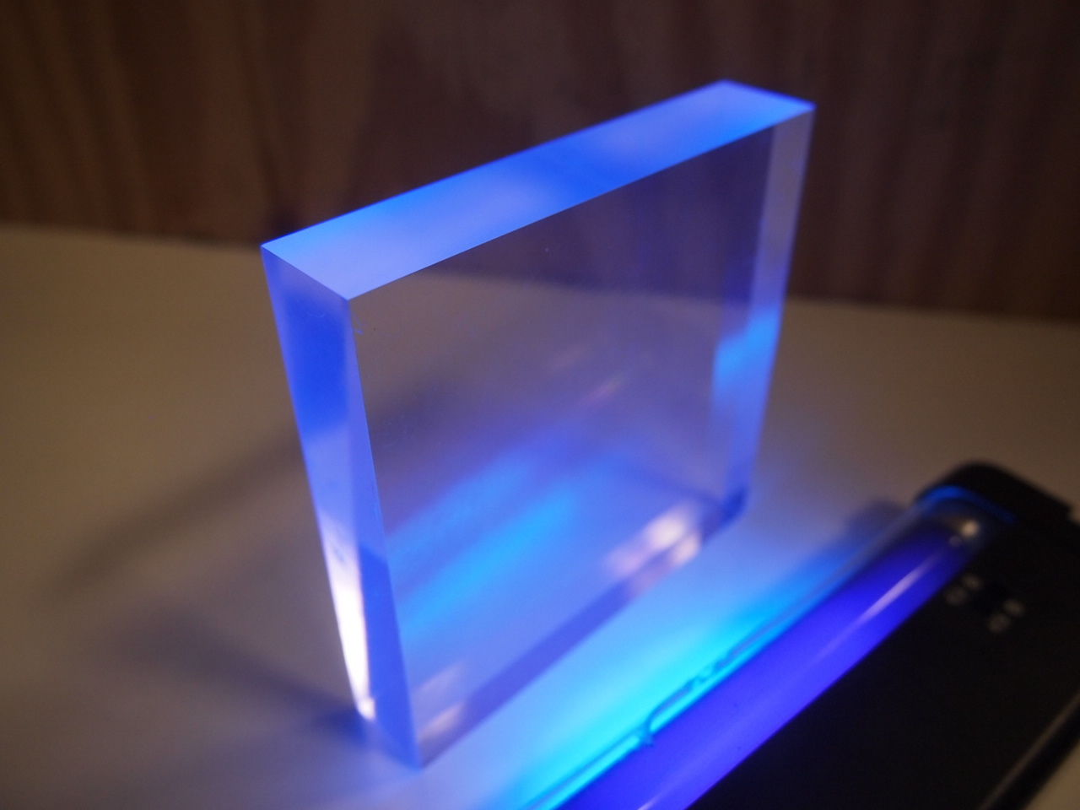
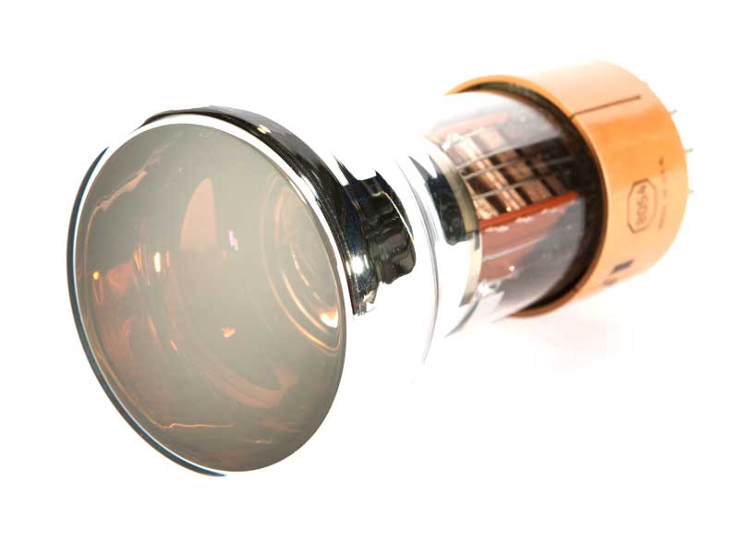
Cosmic Ray Detector
Scintillator Crystal Produces light when struck by cosmic rays
Photomultiplier Tube
Generates analog electronic pulses corresponding to detection of light

Slide 7
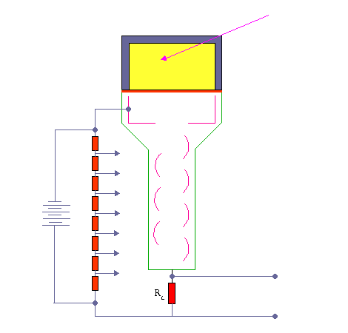
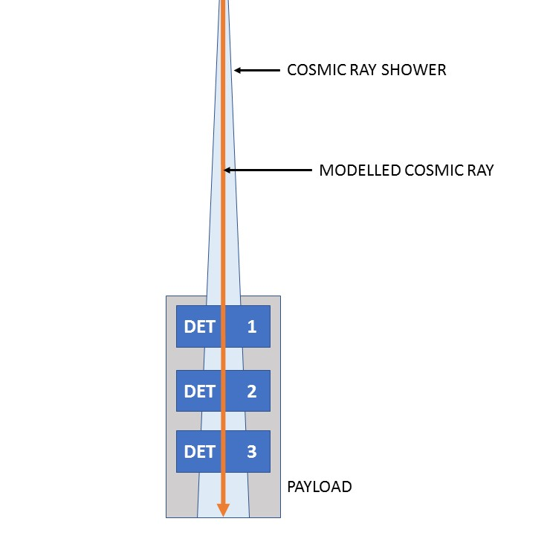
Cosmic Ray Detector

Slide 8
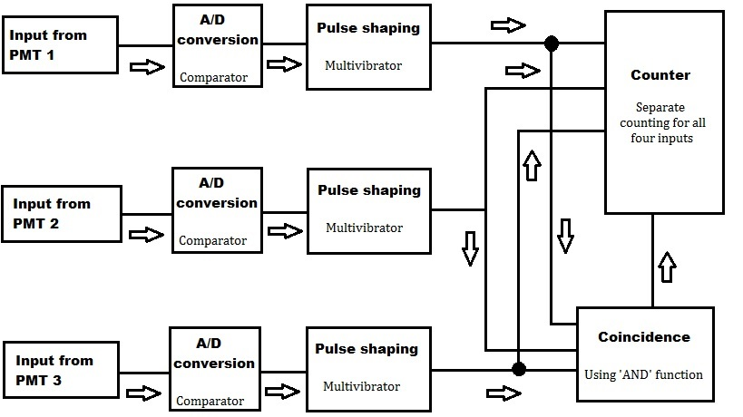
Data Flow

Slide 9

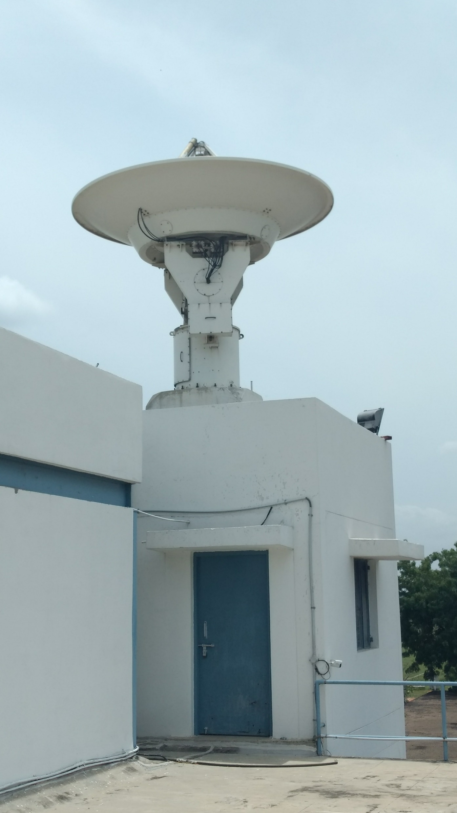
Data Flow
Micro-controller
Data Acquisition System
Telemetry
Tele-command
GPS
Pressure – Temperature sensor
Inertial Measurement Unit
Ground Station
Control Room at TIFR Hyderabad
APEIRO Payload

Slide 10


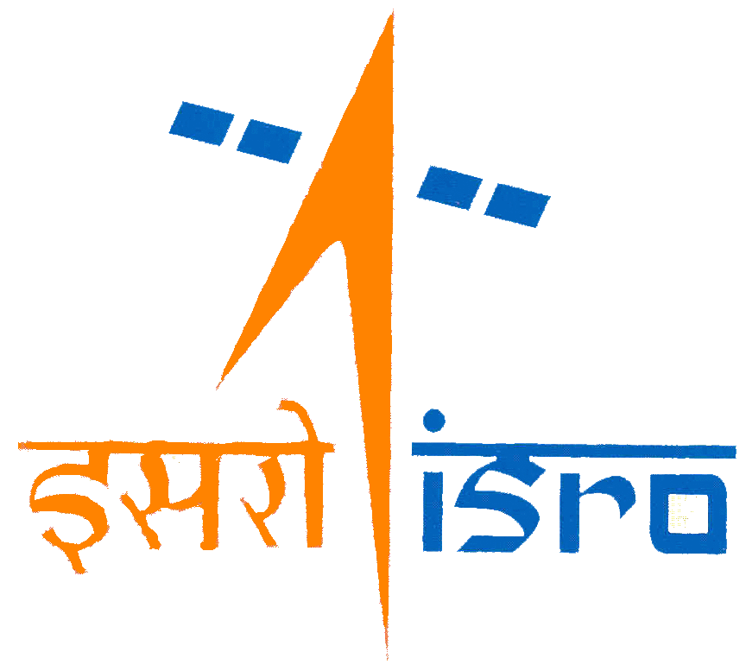
Project Apeiro - Motivation
Astronomy and Astrophysics club of campus

Slide 11
What do we need?
Cosmic Ray Detector
How to detect the charged particles?
How to generate signals?
Data Acquisition
How to collect and store the data?
Data Transmission
How to transmit data over long range?
Testing the equipment
A flight is not possible without testing and calibrating the equipment
Conducting the flight
How to actually fly the payload?
Funding the project
How do we generate funds for the equipment?

Slide 12
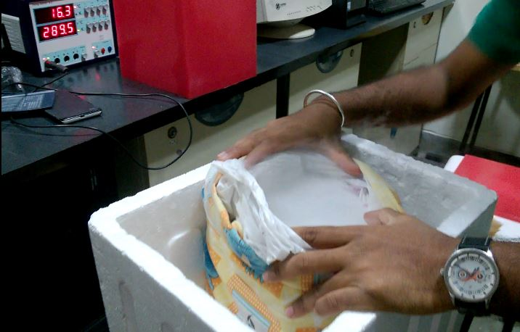
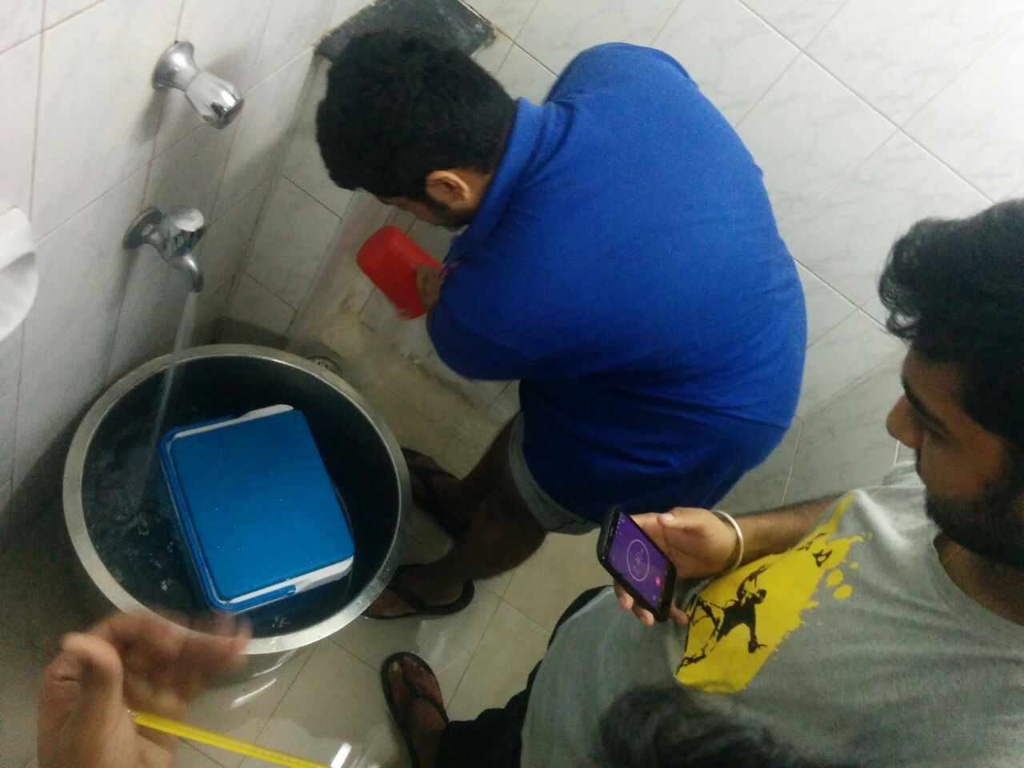
Good old days
Performance test in low temperature conditions using dry ice
Heat flux test

Slide 13
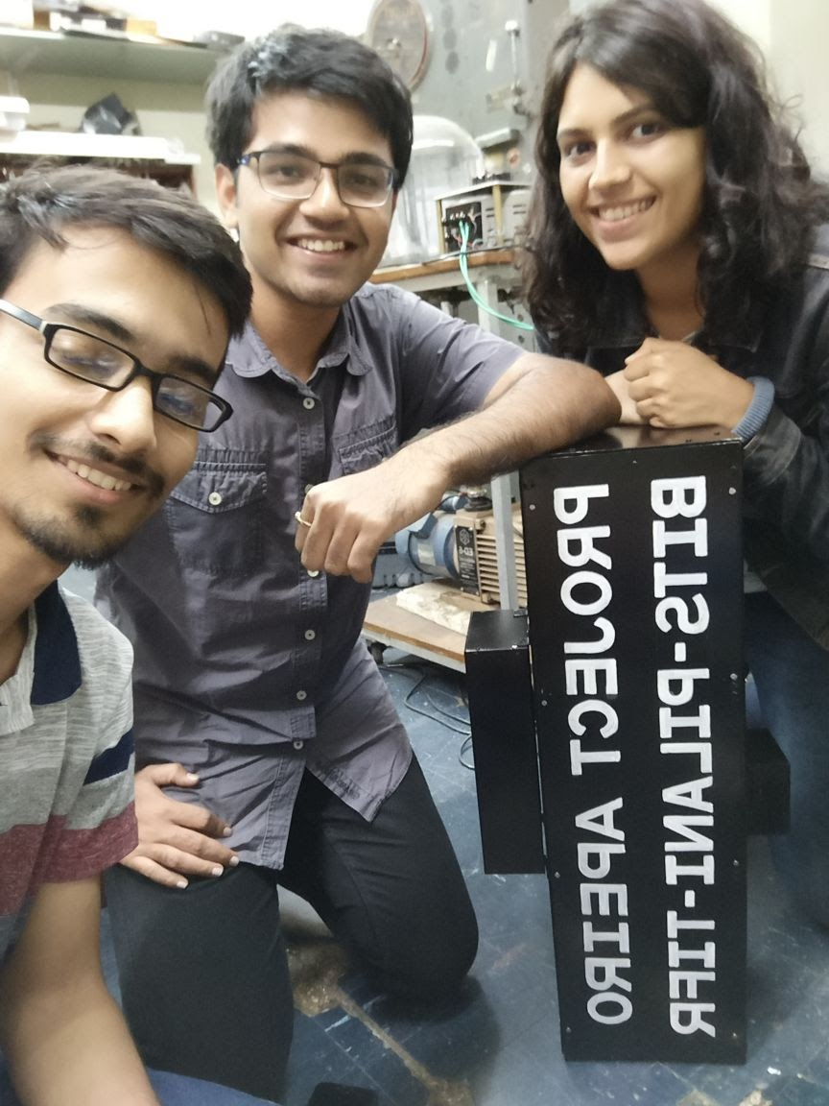
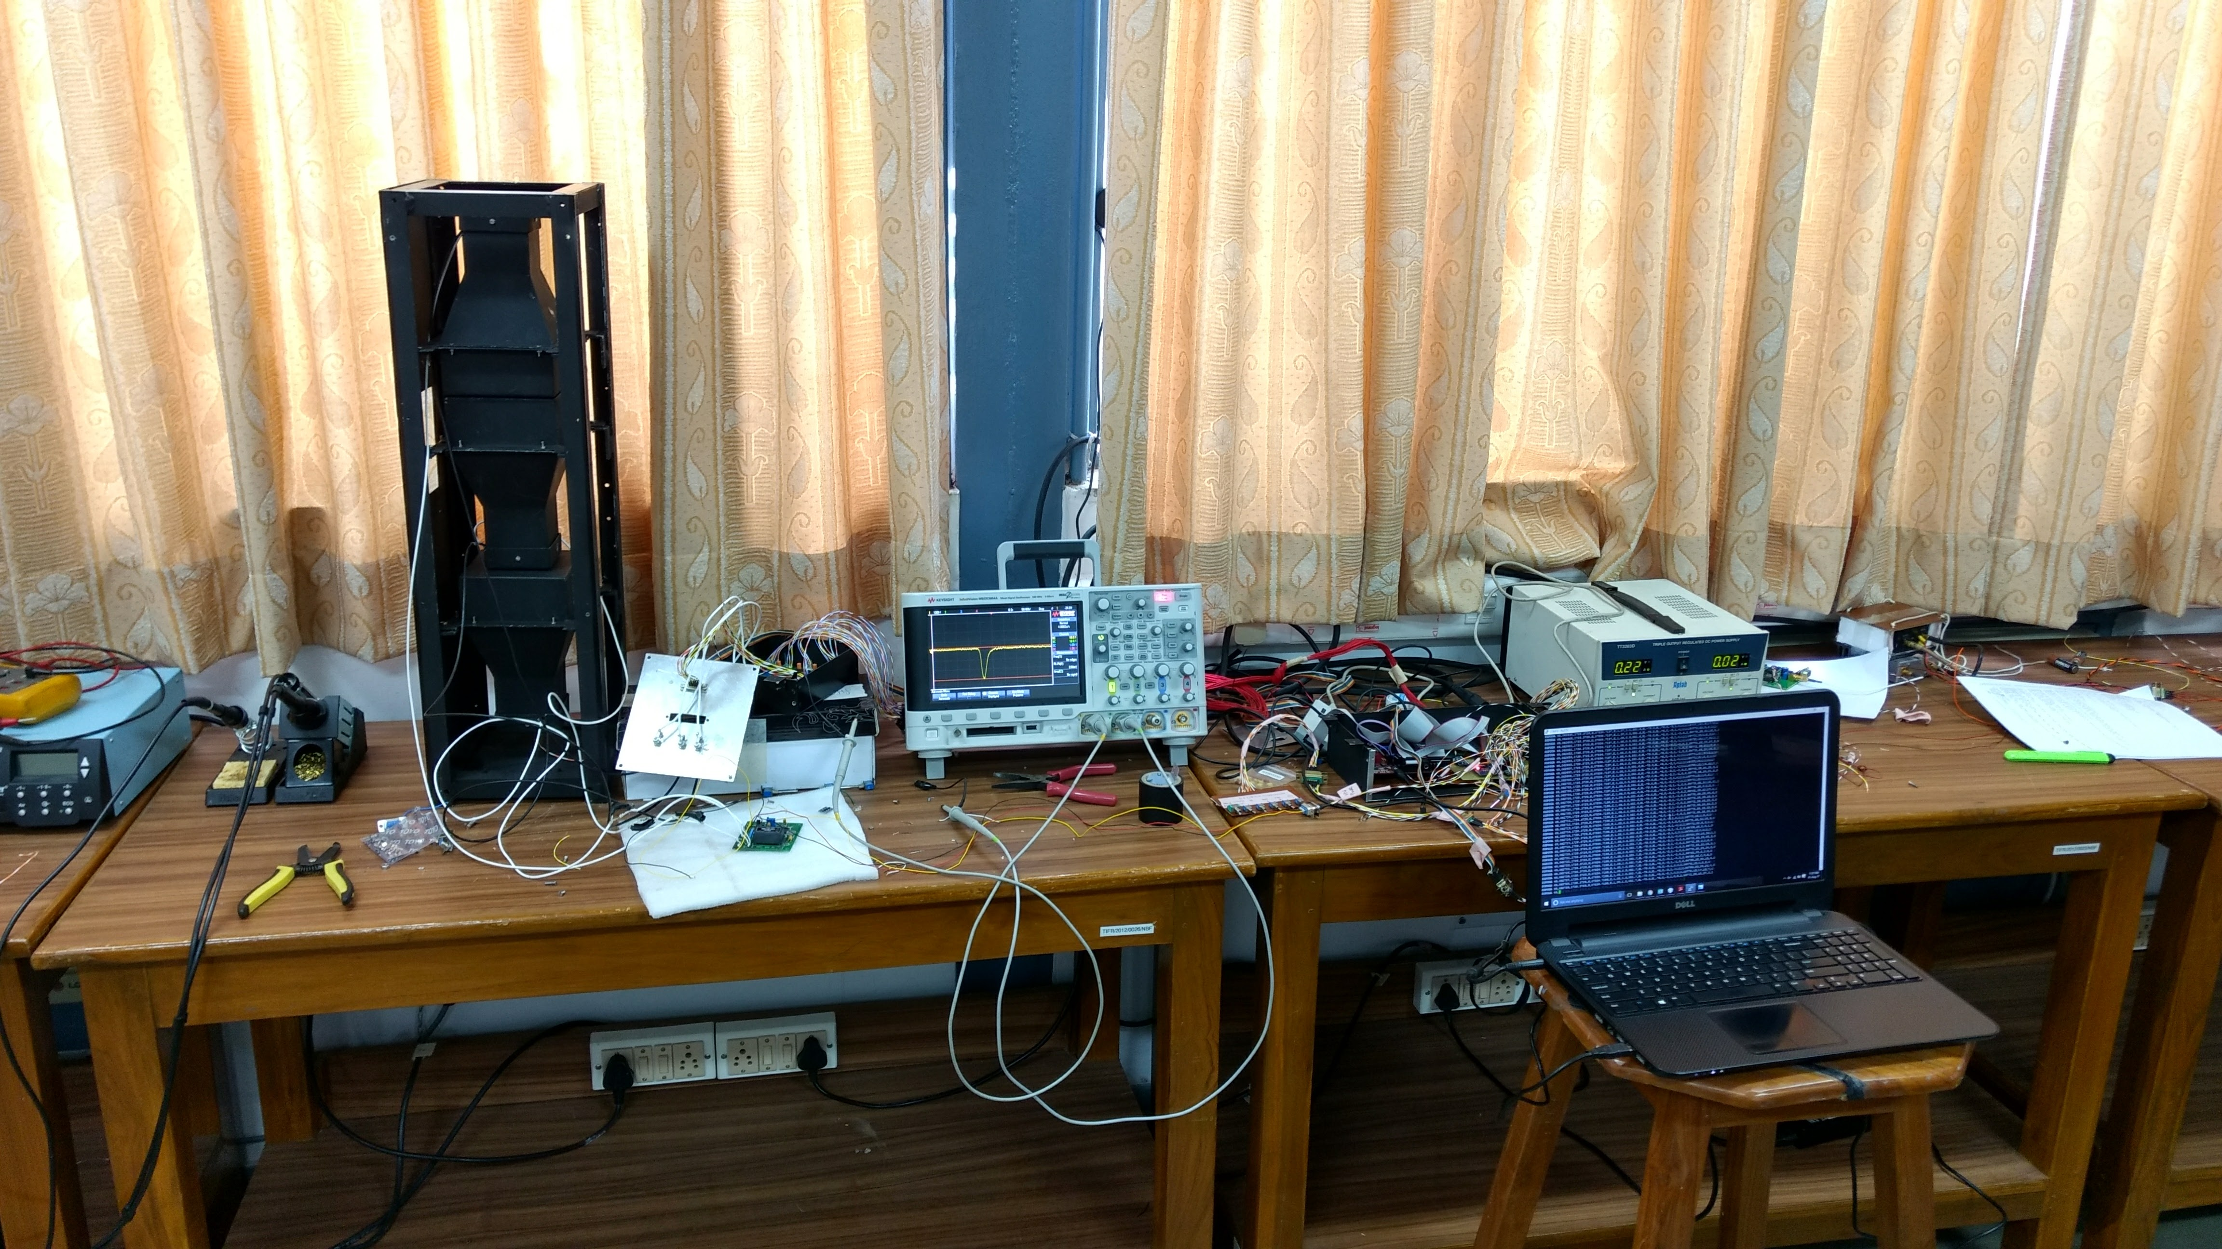

Slide 14
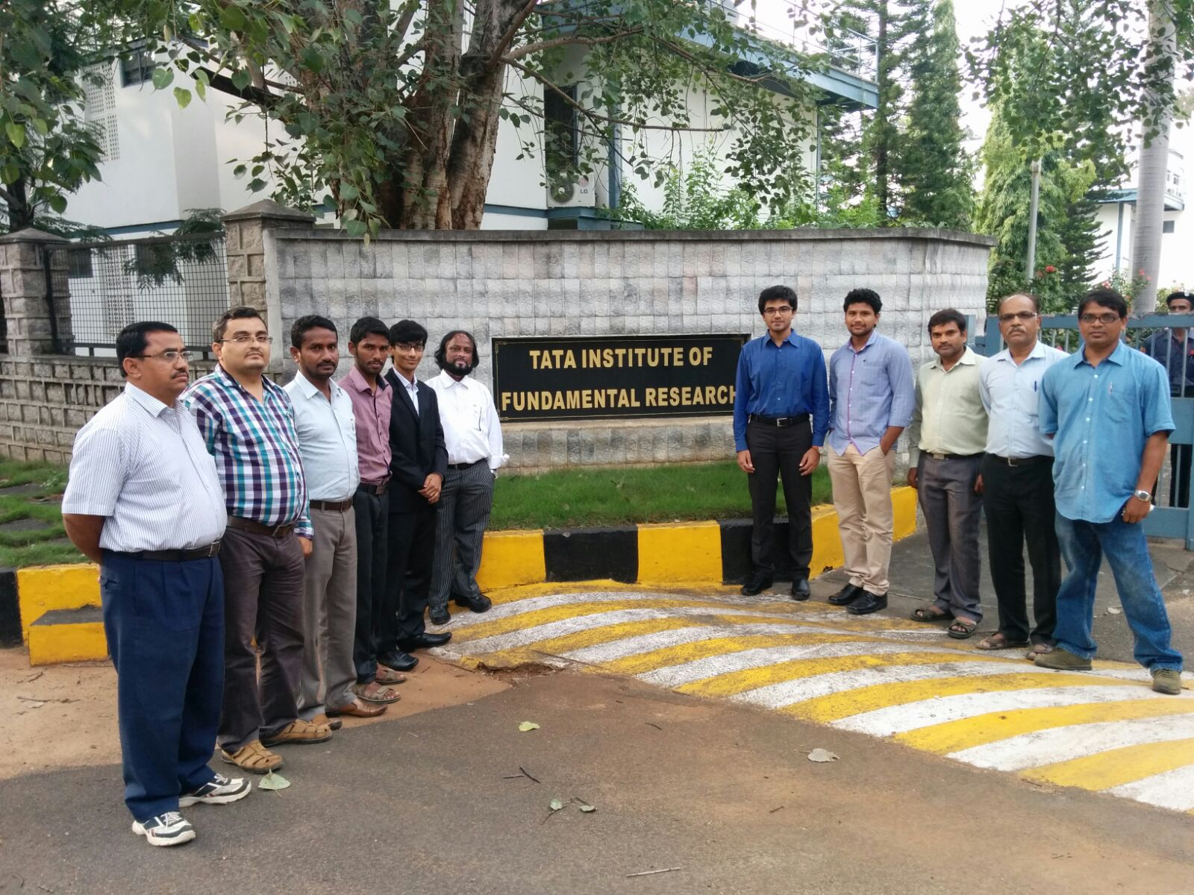
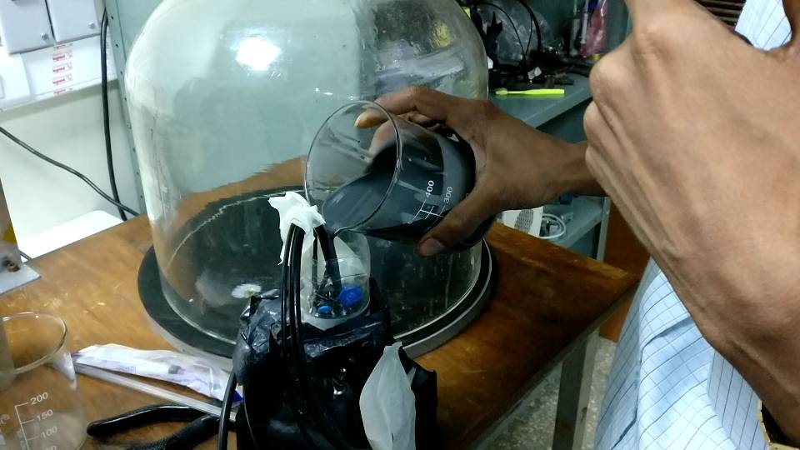
HV protection using rubber composite material
The team at National Balloon Facility, Hyderabad

Slide 15
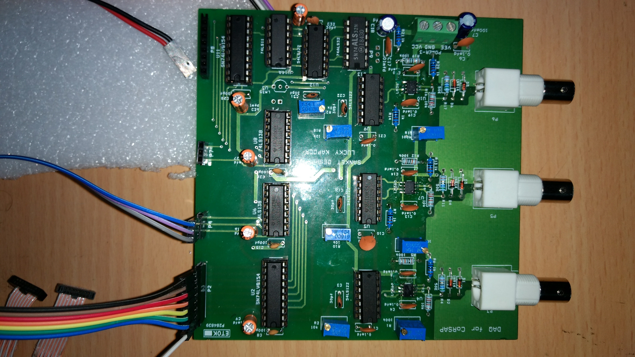
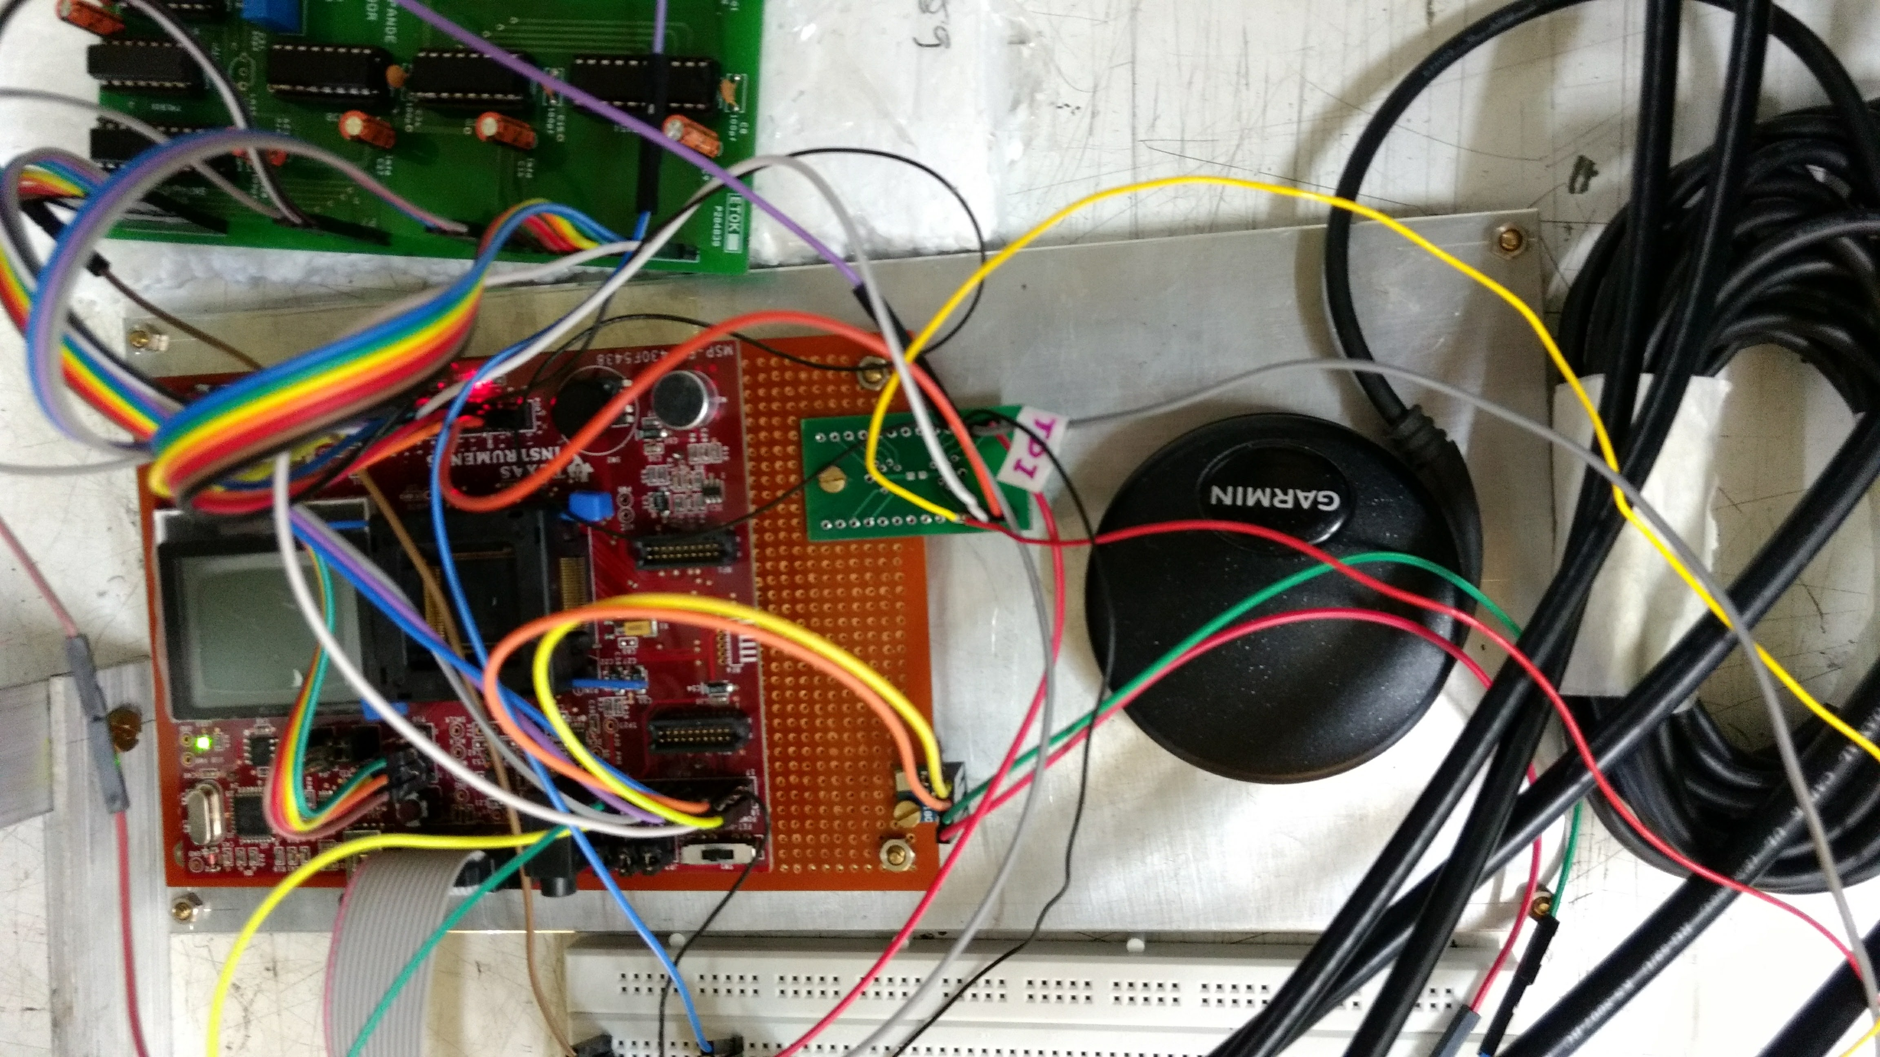
Data Acquisition
Data Acquisition Board
Microprocessor interfaced with GPS and memory

Slide 16
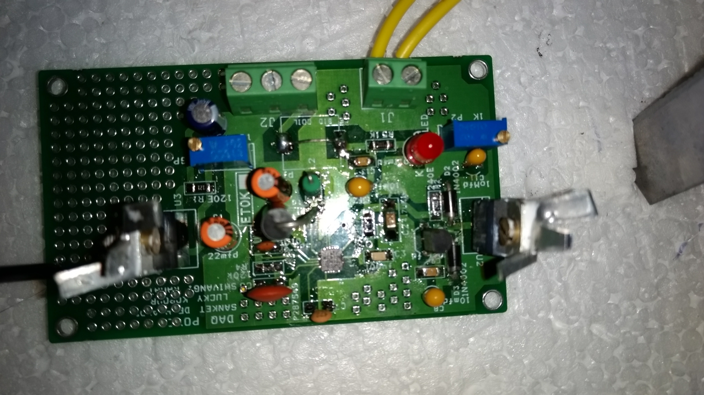
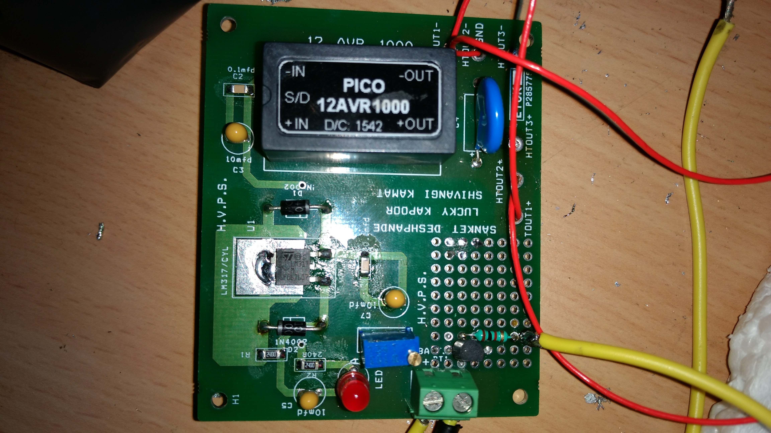
Power Supply
Low Voltage Power Supply
High Voltage Power Supply

Slide 17
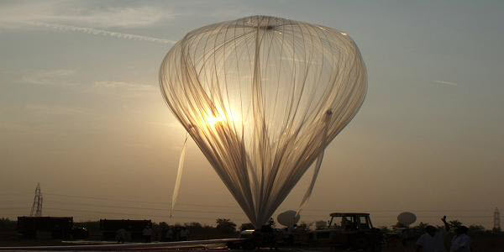
Flight Plan

Slide 18
Flight Plan
Airborne payload will determine cosmic ray flux
It will fly till it reaches an altitude of 25kms above sea level
Data will be collected during the entire flight duration
Data will be stored on-board the payload
Data will also be transmitted to the ground station via telemetry equipment
Essential control signals will be sent by the ground station to the payload via a telecommand system
The payload will be recovered after the flight

Slide 19
Space Grade Equipment
Temperatures falling to -70 degrees Celsius
Vibrations due to balloon flight
Ionization of air molecules leading to fire if exposed to high voltage points
Data recovery issues
Shielding from radiations and EMI

Slide 20
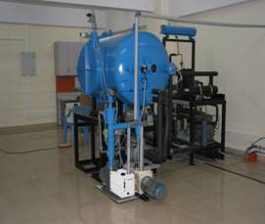
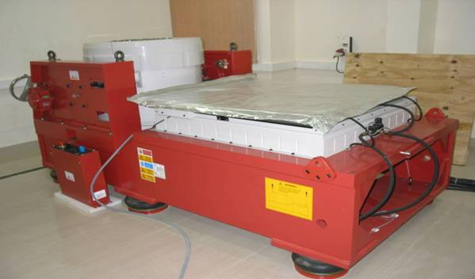
Testing and calibration
Vibration Bench
Thermo Vac Chamber

Slide 21
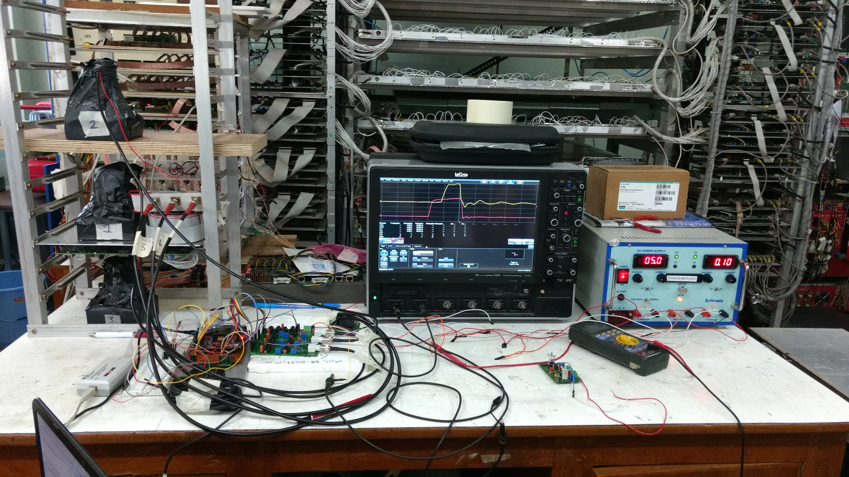
Project then

Slide 22
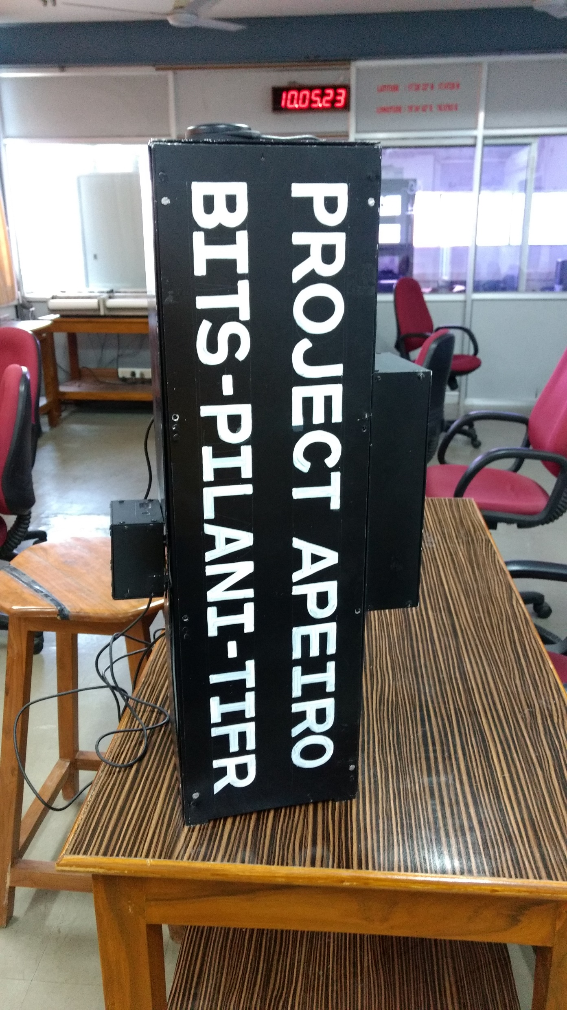
Project now

Slide 23
Future
Interfacing with flight equipment in August 2017
Location: Hyderabad
On-ground data collection and verification during August – December 2017
Location: Hyderabad
Experimental Flight, sometime in December 2017
Location: Hyderabad

Slide 24
Scientific Endeavors
Experimental data analysis
Comparison with existing experimental data
Developing a scientific model
Area specific analysis

Slide 25
Further Merits
Reusability
Can be used for several similar experiments
Recognition
First Indian student high altitude flight
Encouragement
For peers in BITS and other institutes
Collaborations
Opened the doors for collaborative effort
Publications
Impetus to student research activities

Slide 26
Recognition
Collaboration with the India based Neutrino Observatory (INO) group of the Tata Institute of Fundamental Research, Mumbai for scientific expertise, equipment and guidance
Collaboration with the ASTROSAT group of the TIFR, Mumbai for scientific equipment
Collaboration with the National Balloon Facility, TIFR, Hyderabad for conducting the balloon flight

Slide 27
Thank you
Thank you BITS Goa!

